Slide 1
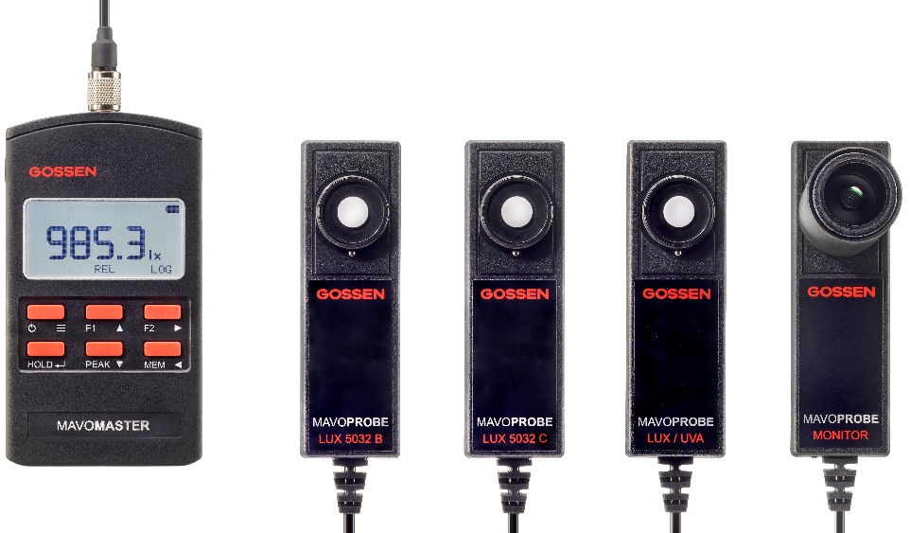
Light measuring SYSTEM
A NEW GENERATION
MAVO MASTER + MAVO PROBE
Notes:
Security is elementary for us.
Always a goal in mind
to make the world safe
__________________________________________________________________________
Security is elementary for us.
Because with everything we develop and produce, we always have one goal in mind:
To make the world a little safer.

Slide 2
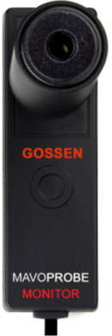
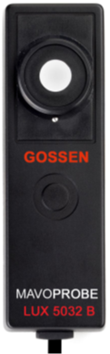
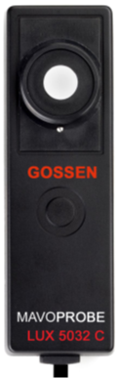
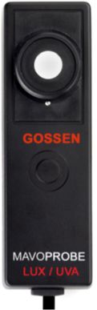
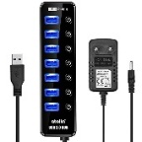
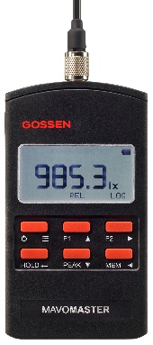





LIGHT measuring SYSTEM
Light measurement technology systematically reinvented
Self-sufficient measuring device
One channel measuring system
Multi-channel measuring system via USB hub
Serial interface
with robust connector
Open
interface
protocol
Adapter
to USB
Software MAVOSOFT
Windows

Slide 3
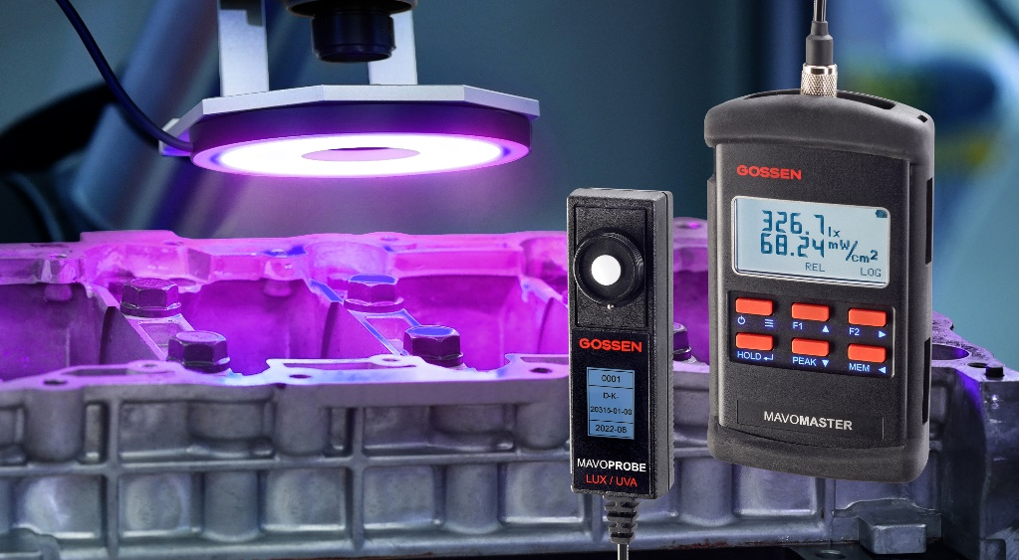
LIGHT MEasuring SYSTEM
New area of application – non-destructive testing
Fluorescent Penetrant and Magnetic Particle Testing
Combination device for illuminance / irradiance UV-A 365 nm
DAkkS calibration certificate for illuminance, irradiance UV-A 365 nm or illuminance and irradiance UV-A 365 nm
No downtime over two offset calibrated MAVOPROBE LUX / UVA with one MAVOMASTER. Measuring probe is calibrated independently.
Measuring device and calibration from a single source
Conforms to DIN EN ISO 3059, ASTM E2297-15, DIN 5032-7 class B
Measured value memory for logging the measurement (CSV file)
Fluorescent button labeling for better readability with UV-A
Shock protection by rubber protective cover
Background information UV Measuring Compendium

Slide 4
LIGHT MEasuring SYSTEM
Key SELLING features - MAVO PROBE
STAND-ALONE METER - Each probe is intelligent,
balanced and outputs the metric in digital form.
CLASSIFIED MEASUREMENT - Each probe is classified according to DIN 5032-7 and meets all the requirements of this standard.
UNIVERSAL APPLICATION - Each probe can be operated with a MAVOMASTER as a self-sufficient measuring device. Alternatively, it can be used inexpensively with an optional USB adapter in single or multi-channel measurement systems.
INDIVIDUAL SYSTEM INTEGRATION - The open interface protocol for device control and data communication allows integration into your own applications.
EASY ADAPTATION - Each probe has a ¼" tripod socket on the back and can be combined with tripods and accessories from the photo sector.
CALIBRATION PROTOCOL INCLUDED - Each probe is supplied with a calibration protocol with a measured value.
OPTIONAL CALIBRATION – Depending on the measured variable, a factory or DAkkS calibration certificate can be issued by the GOSSEN calibration laboratory.
INDEPENDENT CALIBRATION - Each probe is calibrated independently and can be easily shipped at a reduced cost.
SUSTAINABLE DEVICE CONCEPT - The firmware of the probe can be updated via the USB interface and thus enables future extensions and changes.
Customized cable length – The 1.5 m connection cable can be optionally extended with ready-made 3 m, 5 m or 10 m cables.
EXTERNAL POWER SUPPLY – Each probe can be powered via the MAVOMASTER basic unit or the USB interface.

Slide 5
LIGHT Measuring SYSTEM
Key SELLING features - MAVO MASTER
ON-BOARD EVALUATIONS – Integrated measurement functions evaluate the measurement results and thus provide on-site evaluations in real time.
INDIVIDUAL CONFIGURATION – Existing measurement functions can be freely assigned to function keys F1 and F2.
RELATIVE MEASUREMENT - Continuous measurement and display of the absolute measurement quantity - reference value at the start of the measurement mode.
INTEGRAL MEASUREMENT – integration of the measured variable over time, display of the integral value and the time interval that has elapsed since activation – determination of the radiation dose.
GRID MEASUREMENT - Storage of individual measurement points and continuous calculation of average, minima, maxima, uniformity and non-uniformity - Lighting of workplaces.
RATIO MEASUREMENT B/A – Continuous calculation of the ratio of the measured value to the reference value at the start of the measurement function – contrast measurement, luminance distribution.
DEVIATION MEASUREMENT BA – Continuous calculation of the relative deviation of the measured value from the reference value at the start of the measurement function – adjustment of luminance, lighting.
DEVIATION MEASUREMENT %A – Continuous calculation of the percentage deviation of the measured value from the reference value at the start of the measurement function – luminance uniformity, illumination.
DATA LOGGER - Continuous recording of the chronological progression of the measured variables. The measurement data are written to a data file at adjustable time intervals.
PEAK – detection of minimum, maximum, mean values.
HOLD – Freezes the reading display.
MEM - Saving and deleting individual readings.
LARGE DATA MEMORY - 8 GB, readable via USB, device behaves like an external drive.
UNIVERSAL POWER SUPPLY - battery operation, long-term operation via USB interface with power bank, plug-in power supply or PC interface.
COMFORTABLE PROTECTION - Shock protection through optional rubber protective cover with stand for comfortable table operation.
OPTIMUM OPERATION - Fluorescent button labeling for UV-A applications

Slide 6
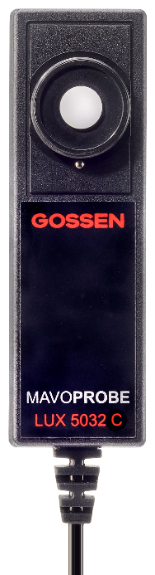
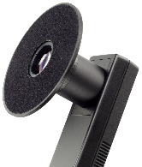
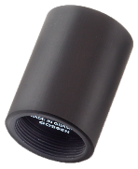
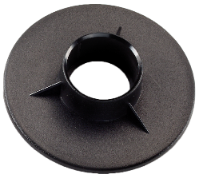
MAVOPROBE LUX 5032 C
Technical specifications
Photometry - Illuminance
Application universal for all light sources
Spectral range (VIS) 380 nm … 780 nm
Illuminance 0.1 lx … 199 990 lx
0.01 fc … 19,999 fc
Classification Class C - DIN 5032-7
Resolution 0.1 lx
Temperature dependence < 0.1%, temperature compensated
Accuracy + 3 % reading + 1 digit
V(λ) adjustment f1' typically f1' < 7.5%
cos – faithful evaluation f2 < 3%
Unit switching lx, fc
Photometry - Luminance with Luminance Attachment
Luminance 1 cd/m² … 1 999 900 cd/m²
0.1 fL … 199 990 fL
Classification no
Resolution 0.1 cd/m²
Accuracy + 8% reading + 1 digit
- adjusted with probe + 4.5% reading + 1 digit
Unit switching cd/m², fL

Slide 7
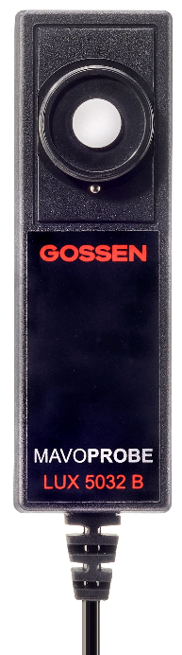
MAVOPROBE LUX 5032 B
Technical specifications
Photometry - Illuminance
Application universal for all light sources
Spectral range (VIS) 380 nm … 780 nm
Illuminance 0.001 lx … 199 990 lx
0.001 fc … 19,999 fc
Classification Class B - DIN 5032-7
Resolution 0.001 lx
Temperature dependence < 0.1%, temperature compensated
Accuracy + 2.5% reading + 1 digit
V(λ) adjustment f1' typically f1’ < 3%
cos – faithful evaluation f2 < 2%
Unit switching lx, fc
Photometry - Luminance with Luminance Attachment
Luminance 0.01 cd/m² … 1 999 900 cd/m²
0.001 fL … 199 990 fL
Classification no
Resolution 0.01 cd/m²
Accuracy + 8% reading + 1 digit
- adjusted with probe + 4.5% reading + 1 digit
Unit switching cd/m², fL

Slide 8
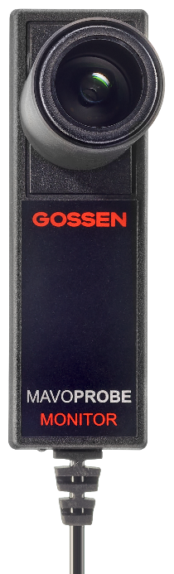
MAVOPROBE MONITOR
TECHNICAL SPECIFICATIONS
Photometry - Luminance
Application Universal for all light sources
Spectral range (VIS) 380 nm … 780 nm
Luminance 0.001 cd/m² … 19 999 cd/m²
0.0001 fL … 19 99 fL
Classification Class B - DIN 5032-7
Resolution 0.001 cd/m²
Temperature dependence < 0.1%, temperature compensated
Accuracy + 2.5% reading + 1 digit
V(λ) adjustment f1' typically f1' < 3%
Unit switching cd/m², fL

Slide 9
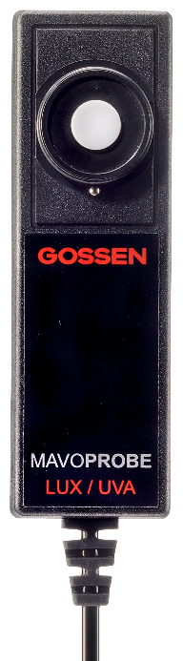
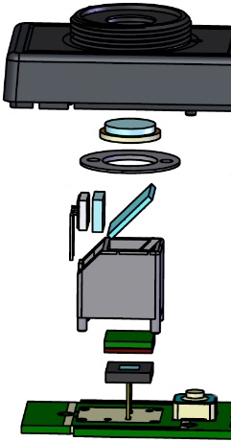
MAVOPROBE LUX / UVA
Technical specifications
Photometry - Illuminance
Application Universal for all light sources
Spectral range (VIS) 380 nm … 780 nm
Illuminance [lux] 0.001 lx … 199 990 lx
0.001 fc … 19,999 fc
Classification Class B DIN 5032-7
Resolution 0.001 lx
Temperature dependence < 0.1%, temperature compensated
Accuracy + 2.5% reading + 1 digit
V(λ) adjustment f1' typically f1' < 3%
cos – faithful evaluation f2 < 2%
Unit switching lx, fc
Radiometry – UVA 365nm
Application UV-A emitters 365 nm , NDT, NDT
Spectral range (UV-A) 300 nm … 400 nm
Irradiance 0.01 µW/cm² … 199 990 µW/cm²
Resolution 0.01 µW/cm²
Accuracy + 10% reading + 1 digit
cos – faithful evaluation f2 < 2%
Standard conformity DIN EN ISO 3059, ASTM E2297-15
UV-A 365nm
filter
diffuser
UV-A
photodiode
UV-A
mirror
mirror
holder
V( λ)
filter
VIS
photodiode
Internal structure of the LUX / UVA probe

Slide 10
MAVOPROBE LUX / UVA
Technical specifications
Photometry - Luminance with Luminance Attachment
Luminance 0.01 cd/m² … 1 999 900 cd/m²
0.001 fL … 199 990 fL
Classification no
Resolution 0.01 cd/m²
Accuracy + 8% reading + 1 digit
- adjusted with probe + 4.5% reading + 1 digit
Unit switching cd/m², fL

Slide 11
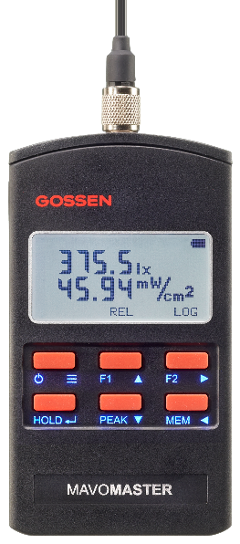
MAVOMASTER
Technical Data - Part 1
Service:
Display FSTN LCD, 128 x 64 pixels, 49 mm x 23 mm,
white background lighting, wide viewing angle,
high contrast, high sharpness
Keyboard 6 keys, silicone rubber with snap effect,
insensitive to dust and splash water,
fluorescent printing, better readability with UV-A
Interfaces & Storage
Interface USB 2.0, Micro USB TYPE B socket
Interface functions Programming, data exchange,
power supply, firmware update
Interface protocol exposed, development kit
Connection measuring pro Binder socket 5-pin, I²C bus
Memory 8 GB, permanently installed

Slide 12
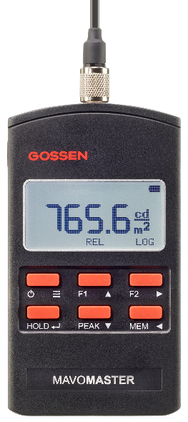
MAVOMASTER
TECHNICAL DATA - Part 2
Power Supply
Battery / rechargeable battery 1.5 V Mignon alkaline manganese cell (IEC LR-6) AA
or corresponding rechargeable battery with ext. charger
Operating time up to 16 hours continuous operation with alkaline manganese battery
Battery control Automatic display of a "BAT" symbol when
battery voltage < 1 V
Continuous operation via USB interface or optional plug
power pack 100…240V (50/60 Hz) 5 VDC 1 A,
or commercial power bank
Energy-saving function programmable display or device shutdown
Miscellaneous
Operating temperature - 10 °C … + 50 °C
Dimensions 65mm x 120mm x 19mm
Weight 100 g excl. battery

Slide 13
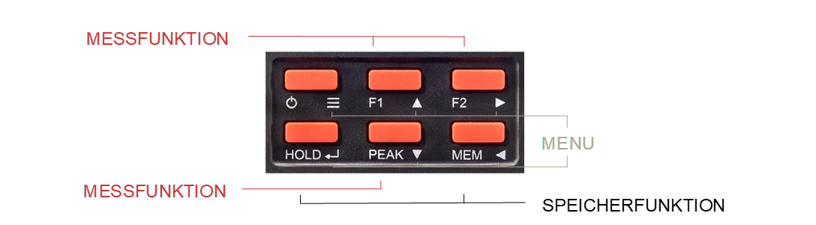
MAVOMASTER
Overview of operating and display elements, setting options

Slide 14
MAVOMASTER
Evaluation on-board - assessment of workplaces AND interior lighting
GRID - Grid Measurement
Start of the measurement function resets all function values
Display of current measured value and number n of stored measured values
MEM saves the current measured value and calculates all function values using the saved values
PEAK shows E _{mean} , E _{max} , E _{min} , U ₀ , U _{D}
Ending the measurement function generates a query to save the function values in a file
Application - assessment of workplaces and interior lighting

Slide 15



MAVOMASTER
On-board evaluation – deviation and ratio measurements
BA – Deviation Measurement
Start of the measuring function takes the current measured value as the reference value
Display of current measured value, deviation from reference value A and number n of stored measured values
MEM saves the current reading and the deviation
PEAK displays MIN, MAX, AVG of the stored values
Ending the measurement function generates a query to save the function values in a file
Application – determination of absolute deviations
%A - Deviation Measurement
Start of the measuring function takes the current measured value as the reference value
Display of current measured value, deviation from reference value A in % and number of stored measured values
MEM saves the current reading and the deviation
PEAK displays MIN, MAX, AVG of the stored values
Ending the measurement function generates a query to save the function values in a file
Application - Determination of the uniform illumination of screens, projection or work surfaces
B/A - Ratio Measurement
Start of the measuring function takes the current measured value as the reference value
Display of the current measured value, the ratio of the measured value to the reference value A and the number of saved measured values
MEM saves the current reading and the deviation
PEAK displays MIN, MAX, AVG of the stored values
Ending the measurement function generates a query to save the function values in a file
Application – contrast measurement, determination of the luminance distribution at the workplace

Slide 16



MAVOMASTER
On-board evaluation – RELATIVE, integral measurement and DATA LOGGER
REL - Relative Measurement
Start of the measuring function takes the current measured value as the reference value
Display of current measured value - reference value
MEM saves the current measured value - reference value in a file
PEAK displays MIN, MAX, AVG of current values
Application – measurement of artificial lighting with available daylight
INT - Integral Measurement
Start of the measuring function begins with the integration of the current measured value
Display of integral value and time elapsed since activation
Ending the measurement function generates a query to save the function values in a file
Application – measurement of the UV radiation dose
LOG - Data Logger
Start of the measurement function begins with the countdown of the set storage interval HH:MM:SS
Display of the current measured value, storage of the current measured value in the set storage interval
Ending the measurement function closes the data file with the saved measurement values
Application - Acquisition of lighting profiles over a period of time

Slide 17

MAVOMASTER
Memory functions AND EXTREME VALUES with normal measuring function
HOLD
HOLD (briefly) freezes the measured value display and switches on the display lighting depending on the setting
HOLD (briefly) releases the measured value display again
MEM
MEM (short) saves individual measured values as Realtime_xxxx.csv or Realtime_hh-mm-ss.csv, depending on the setting
MEM (long) Delete individual measured values
PEAK
PEAK (short) shows extreme values MAX / MIN / AVG
PEAK (long) resets extreme values MIN / MAX / AVG

Slide 18
Thank you for your attention!
If you have any further questions or suggestions, please contact:

